Slide 1
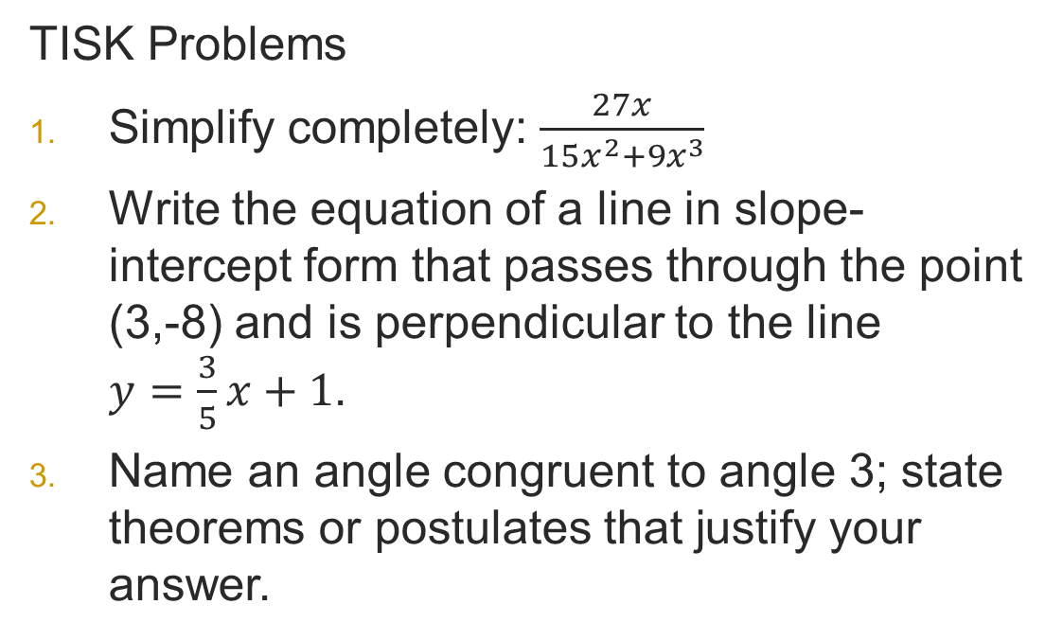
Monday, February 11, 2013 Agenda
TISK & 2 MM
Lesson 9-5: Tangents
Homework: 9-5 problems in packet 2
TISK Problems
Simplify completely: $\frac{27x}{15x^{2}+{9x}^{3}}$
Write the equation of a line in slope-intercept form that passes through the point (3,-8) and is perpendicular to the line $y=\frac{3}{5}x+1$.
Name an angle congruent to angle 3; state theorems or postulates that justify your answer.
2
1
3
4
5
6
Notes:
Mental Math
1.) Start with 14 squared. (196) Add the smallest perfect square that’s greater than 1. (196 + 4 = 200) Take half. (100) Take the square root. (10) Subtract the smallest odd perfect square. (10 – 9 = 1) Write your answer.
2.) Start with 15 squared. (225) Divide by 5. (45) Add one less than the product of 4 and 5. (45 + 19 = 64) Take the square root. (8) Add the opposite of 3 groups of 2. (8 + -6 = 2) Write your answer.

Slide 2
§9-5 Tangents
Definitions
Secant
Tangent
A secant is a line that passes through a circle, intersecting the circle twice.
A tangent is a line that passes through a circle, intersecting the circle exactly once.
The point where the line intersects the circle is called the point of tangency.

Slide 3
More Definitions
Definitions
Tangent Circles
Two circles are tangent if they intersect in only one point.

Slide 4
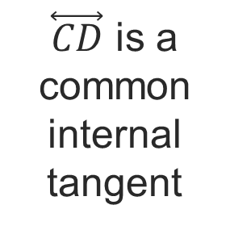
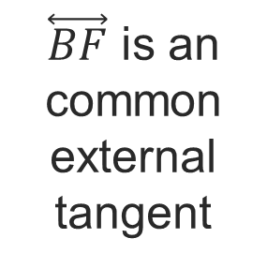
More Definitions
$\overset{⃡}{CD}$ is a common internal tangent
Definitions
Tangent Circles
Common Tangent
Internal
External
Two circles are tangent if they intersect in only one point.
Common internal tangents are “between” the two circles.
$\overset{⃡}{BF}$ is an common external tangent
Common external tangents are “outside” the two circles.

Slide 5
Theorems
If a line is tangent to a circle, then it is perpendicular to the radius drawn to the point of tangency.
P
l
Q

Slide 6
Theorems
In a plane, if a line is perpendicular to a radius of a circle at its endpoint on the circle, then the line is tangent to the circle.
P
l
Q

Slide 7
Theorems
Theorem
If two segments from the same exterior point are tangent to a circle, then they are congruent.

Slide 8
Example 1. Find the value of x.

Slide 9
Example 2. Find the value of x.

Slide 10
Your Turn:
Find the values of x, y, and z in the diagram.

Slide 11
Your Turn:
Find the values of x, y, and z in the diagram.

Slide 12
Your Turn:
Find the values of x, y, and z in the diagram.

Slide 13
Prove it!
Given:
Prove:

Slide 14
Prove it!
Given:
Prove:

Slide 15
Prove it!
Given:
Prove:

Slide 16
Prove it!
Given:
Prove:

Slide 17
Prove it!
Given:
Prove:

Slide 18
Prove it!
Given:
Prove:

